Slide 1
Introduction to Python Programming 22PLC202 Module 1
AUTOMATE THE BORING STUFF WITH PYTHON
BY
AL SWEIGART

Slide 2
What is python programming? And why do we need it?

Slide 3
Python is a computer programming language used to build websites and software, automate tasks and conduct data analysis.

Slide 4
What are the real world applications?
Web development
Game development
AI and ML
Software development and etc.....

Slide 5
Use python for...
Web Development: Django, Pyramid, Bottle, Tornado, Flask, web2py
GUI Development: tkInter, PyGObject, PyQt, PySide, Kivy, wxPython
Scientific and Numeric: SciPy, Pandas, IPython
Software Development: Buildbot, Trac, Roundup
System Administration: Ansible(open source), Salt, OpenStack, xonsh

Slide 6
Advantages of using python
Large developer community
Wide range of Libraries
Write less do more
Very concise syntax

Slide 7
Difference between c and python
C
C is a procedure oriented language.
Compulsory to declare data type of a variable.
For, while, do-while loops.
Switch statement.
Doesn’t allow exception handling.
Middle level languauge.
Memory management needs to be done manually.
Python
Object oriented language.
Data type declaration is not required.
For and while loop.
No switch statement.
Allows exception handling.
High level language.
Memory management automatically handled by python.

Slide 8
Who invented and when?

Slide 9
It was created by Guido van Rossum, and released in 1991.

Slide 10
PYTHON BASICS
Simple and Easy to code
Free an open source
Robust standard library – image, database, testing etc
Interpreted – source code executed line by line – not compiled
Portable – same code used on different machines
Object oriented and procedure oriented
Extensible with other languages
Support for GUI
Dynamically typed data

Slide 11
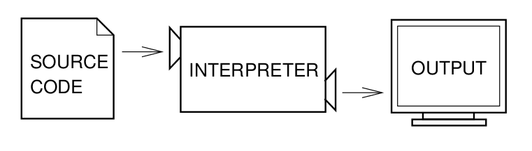
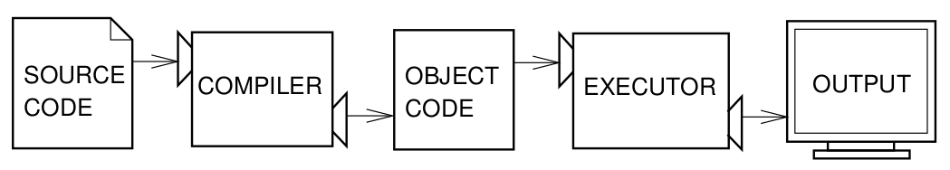

Slide 12
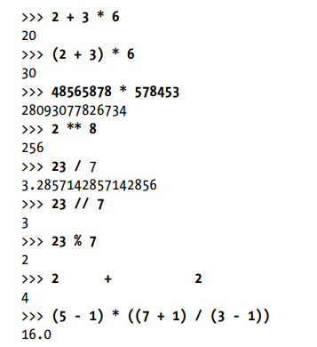
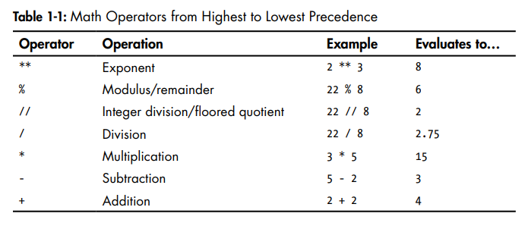
Math Operators

Slide 13
String in Python
Strings in python are surrounded by either single quotation marks, or double quotation marks.
'hello' is the same as "hello".

Slide 14
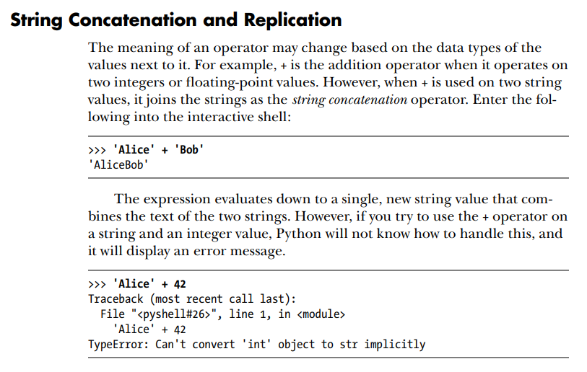

Slide 15
* Operator
The * operator is used for multiplication when it operates on two integer or floating-point values.
But when the * operator is used on one string value and one integer value, it becomes the string replication operator.
>>> 'Alice' * 5
'AliceAliceAliceAliceAlice'

Slide 16
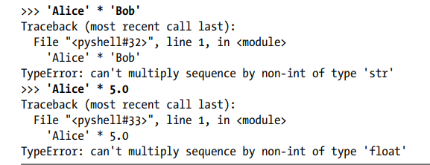
The * operator can be used with only two numbers (for multiplication)
or one string value and one integer value (for string replication).
Otherwise, Python will just display an error message

Slide 17
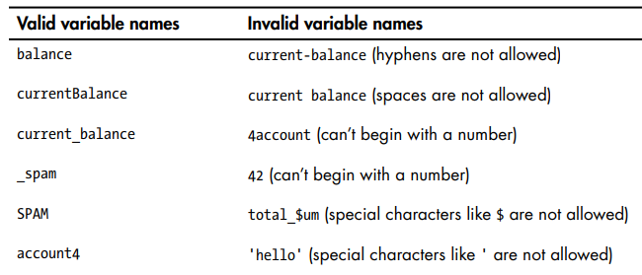
Variables
Name a variable anything as long as it obeys the following three rules:
1. It can be only one word.
2. It can use only letters, numbers, and the underscore ( _ ) character.
3. It can’t begin with a number.

Slide 18
Variable names are case-sensitive, meaning that spam, SPAM, Spam, and sPaM are four different variables.
It is a Python convention to start your variables with a lowercase letter.
A good variable name describes the data it contains.

Slide 19
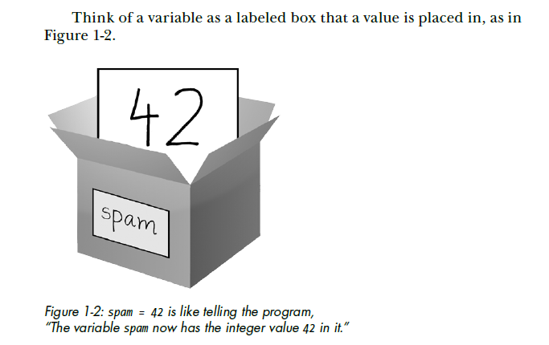
Variables

Slide 20
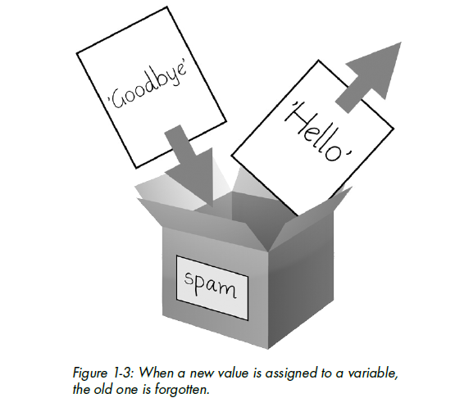

Slide 21
First program – hello.py
# This program says hello and asks for my name and age.
# Comment Line begins with #
print('Hello world!') # Output function
print('What is your name?') # ask for the name
myName = input() # Input Function and assignment to variable
print('It is good to meet you, ' + myName)
print('The length of your name is:')
print(len(myName))
print('What is your age?') # ask for the age
myAge = input()
print('You will be ' + str(int(myAge) + 1) + ' in a year.')

Slide 22
Comments
#
# This program says hello and asks for my name.

Slide 23
The print() Function
The print() function displays the string value inside the parentheses on the screen.
print('Hello world!')
print(2)
print() - This function put a blank line on the screen

Slide 24
The input() Function
The input() function waits for the user to type some text on the keyboard and press enter.
myName = input()
This function call evaluates the user input as text (String only) and assigns the myName variable to this string value
I.e.., the input() function always returns a string, even if the user enters a number

Slide 25
print('Enter your name')
myName = input()
Syntax : input(prompt)
Prompt (Optional): A String, representing a default message before the input.
myName = input('Enter your name')

Slide 26
num = input('Enter a number’)
num
a=num+3
#Error
num = int(input('Enter a number'))
a=num+3
num = input('Enter a number')
num=int(num)
a=num+3
num = input('Enter a number')
a=int(num)+3

Slide 27
print('Enter your number')
num = int ( input() )
num=num + 2
print(‘The number is‘ + num)

Slide 28
The len() Function
Function takes a string value and returns an integer value – which is the number of characters in that string.
>>>len(‘Hello’)
5
>>>len(‘My name is ABC’)
14
>>>len(‘ ‘)
0
>>>len(myName)
Error
>>>len(‘ ‘)
1

Slide 29
The str(), int(), and float() Functions
The str(), int(), and float() functions will evaluate to the string, integer, and floating-point forms of the value you pass, respectively.
>> print('I am ' + ’29’ + ' years old.') Valid?
I am 29 years old.
>>> print('I am ' + 29 + ' years old.') Invalid ?
Traceback (most recent call last):
File "", line 1, in print('I am ' + 29 + ' years old.')
TypeError: Can't convert 'int' object to str implicitly

Slide 30
Python gives an error because the + operator can be used only to add two integers together or concatenate two strings.
An integer cannot be added to a string because this is ungrammatical in Python.
This can be fixed by converting the integer to string
Examples
str(myAge)
str(29)

Slide 31
The int() function is used when a number is in a string value and it needs to be converted to integer to use in some mathematics.
myAge = input()
print('You will be ' + str(int(myAge) + 1) + ' in a year.')
When age is input as 23 by user, myAge = ‘23’ , hence 1 cannot be directly added to it
So, int(myAge) converts string ‘23’ to integer 23, so that 1 can be added to become 24
Now str(24) converts to ‘24’ and the output of print statement is
You will be 24 in a year.
The int() function is also useful if a floating-point number needs to be rounded down
>>> int(7.7)
7
>>> int(7.7) + 2 ???

Slide 32
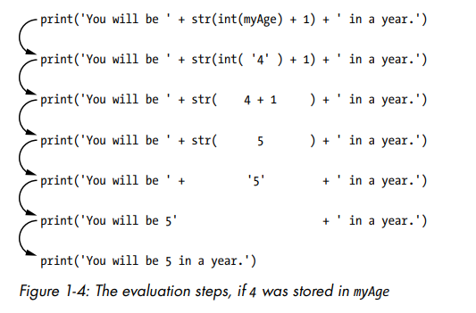

Slide 33
Examples
>>> str(0)
'0'
>>> str(-3.14)
'-3.14'
>>> int('42')
42
>>> int('-99')
-99
>>> int(1.25)
1
>>> int(1.99)
1
>>> float('3.14')
3.14
>>> float(10)
10.0

Slide 34
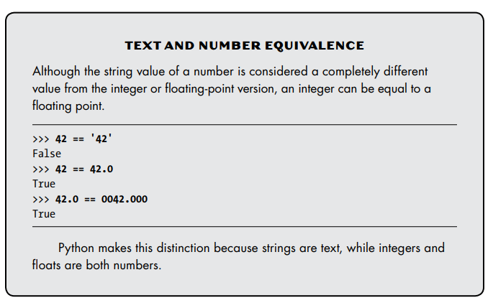

Slide 35
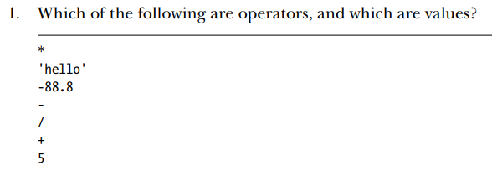
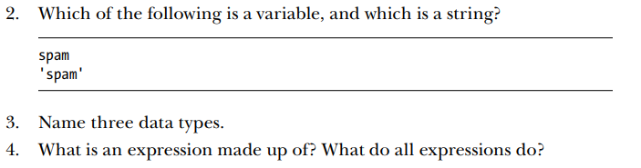
Recap

Slide 36
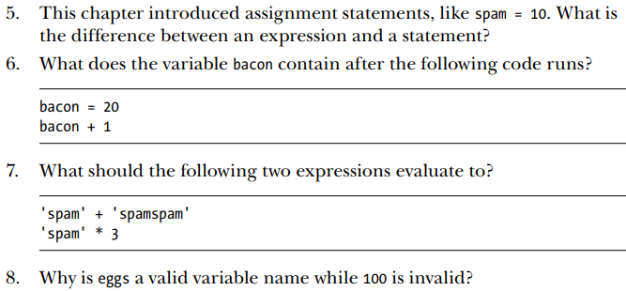

Slide 37
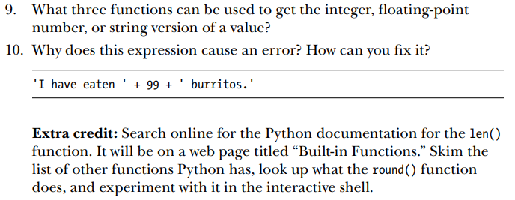

Slide 38
1 a. Develop a program to read the student details like Name, USN, and Marks in three subjects. Display the student details, total marks, and percentage with suitable messages
Output:
Enter the name of a student:Alice
Enter the usn of a student:4NI22CS000
Enter the marks of subject1:90
Enter the marks of subject2:85
Enter the marks of subject3:78
Student details are:
Name of the student: Alice
Usn of the student: 4NI22CS000
Marks in subject1: 90
Marks in subject2: 85
Marks in subject3: 78
Total: 253
Perecntage: 84.33333333333334

Slide 39
name=input("Enter the name of a student:")
usn=input("Enter the usn of a student:")
m1=int(input("Enter the marks of subject1:"))
m2=int(input("Enter the marks of subject2:"))
m3=int(input("Enter the marks of subject3:"))
total=m1+m2+m3
per=(total/300)*100
print("Student details are:")
print("Name of the student:",name)
print("Usn of the student:",usn)
print("Marks in subject1:",m1)
print("Marks in subject2:",m2)
print("Marks in subject3:",m3)
print("Total:",total)
print("Perecntage:",per)

Slide 40
FLOW CONTROL
A program is a series of instructions.
But the real strength of programming isn’t just running (or executing) one instruction after
Based on how the expressions evaluate, the program can decide to skip instructions, repeat them, or choose one of several instructions to run.
Flow control statements can decide which Python instructions to execute under which conditions.

Slide 41
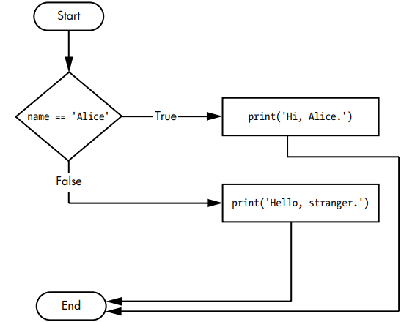
Importance of Flow Chart for flow control statements
if name == 'Alice':
print('Hi, Alice.')
else:
print('Hello, stranger.')

Slide 42
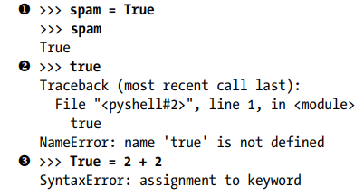
Boolean Values
While the integer, floating-point, and string data types have an unlimited number of possible values, the Boolean data type has only two values: True and False.
Boolean - the data type is named after mathematician George Boole.
When used as Python code, the Boolean values True and False don’t need the quotes around it
They always start with a capital T or F, with the rest of the word in lowercase.
Boolean values are used in expressions and can be stored in variables

Slide 43
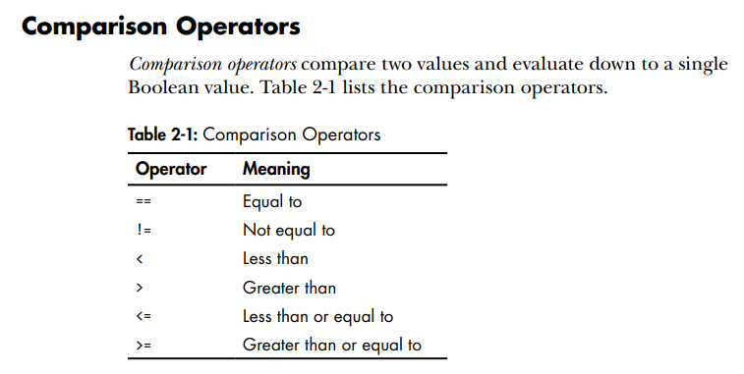
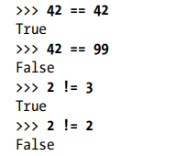
These operators evaluate to True or False depending on the values given.

Slide 44
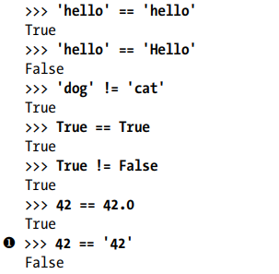
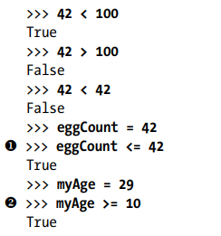
The == and != operators can actually work with values of any data type.
The <, >, <=, and >= operators, work only with integer and floating-point values

Slide 45
Difference between = and == operators ???
Binary Boolean Operators
The three Boolean operators - and, or, not are used to compare Boolean values.
The and and or operators always take two Boolean values (or expressions), so considered as binary operators
whereas not takes one Boolean value (or expression)

Slide 46
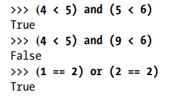
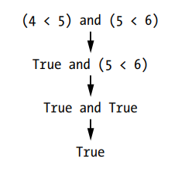
Mixing Boolean and Comparison Operators
Since the comparison operators evaluate to Boolean values, they can be used in expressions with the Boolean operators.
The computer will evaluate the left expression first, and then it will evaluate the right expression, When the Boolean value for both is known, it then evaluates the whole expression down to one Boolean value.

Slide 47
( 4 > 5 ) and ( 5 < 6 )
What is the order of evaluation???

Slide 48
Elements of Flow Control
Flow control statements start with a part called the Condition, and all are followed by a block of code called the Clause.
Conditions - The Boolean expressions can be considered conditions, which are the same thing as expressions
Conditions always evaluate down to a Boolean value, True or False.
A flow control statement decides what to do based on whether its condition is True or False
Clause : Blocks of Code - Lines of Python code can be grouped together in blocks.
A block begins and ends from the indentation of the lines of code.
There are three rules for blocks.
Blocks begin when the indentation increases.
Blocks can contain other blocks.
Blocks end when the indentation decreases to zero or to a containing block’s indentation

Slide 49
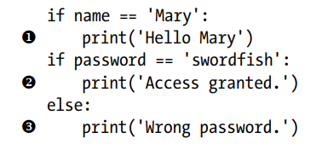
Indentation
There are three blocks of code

Slide 50
Flow Control Statements
if Statements
if else Statements
elif Statements
while Loop Statements
break Statements
continue Statements
for Loops and range() function

Slide 51
if Statements
if condition :
block of code (clause)
An if statement’s clause is executed if the statement’s condition is True.
The clause is skipped if the condition is False.
In Python, an if statement consists of the following:
The if keyword
A condition (that is, an expression that evaluates to True or False)
A colon
An indented block of code (called the if clause) – in the next line

Slide 52
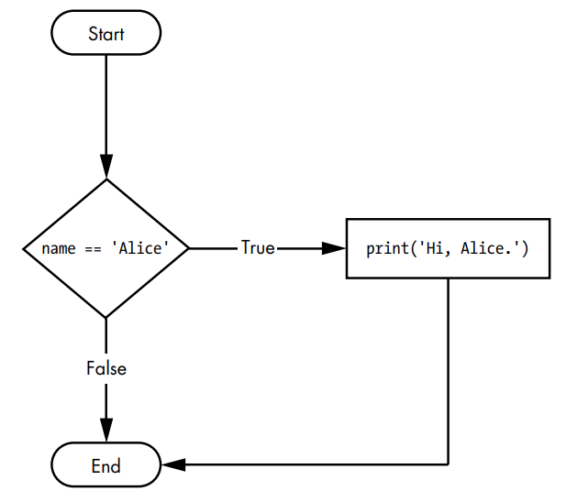
if name == 'Alice':
print('Hi, Alice.‘)

Slide 53
else Statements
if condition :
block of code 1 (clause 1)
else:
block of code 2 (clause 2)
An if clause can optionally be followed by an else statement.
The else clause is executed only when the if statement’s condition is False.
An else statement doesn’t have a condition,
In code, an else statement always consists of the following:
The else keyword
A colon (:)
An indented block of code (called the else clause) - in next line,

Slide 54
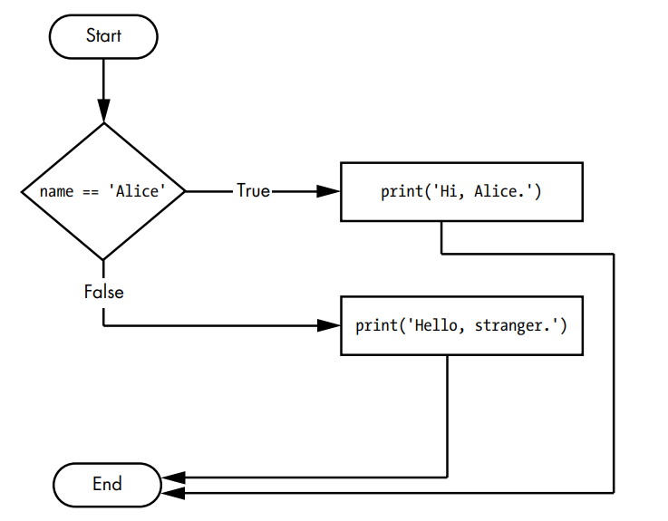
if name == 'Alice':
print('Hi, Alice.')
else:
print('Hello, stranger.')

Slide 55
elif Statements
if condition1 :
block of code 1 (clause 1)
elif condition2 :
block of code 2 (clause 2)
.
.
elif condition n :
block of code n (clause n)
The elif statement is an “else if” statement that always follows an if or another elif statement.
It provides another condition that is checked only if any of the previous conditions were False.
In code, an elif statement always consists of the following:
The elif keyword
A condition (that is, an expression that evaluates to True or False)
A colon (:)
Starting on the next line, an indented block of code (called the elif clause)

Slide 56
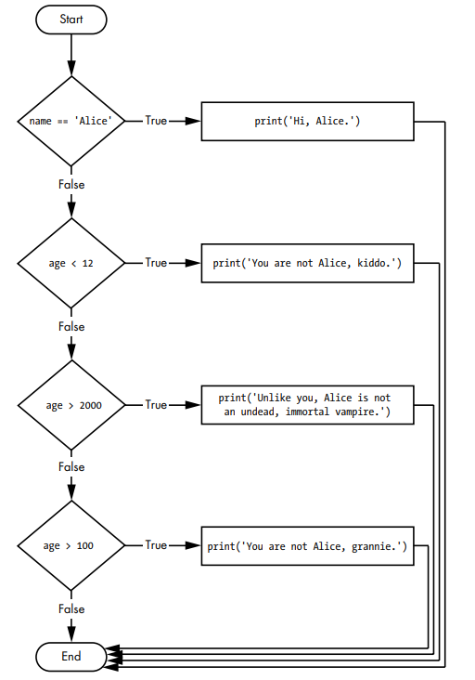
if name == 'Alice':
print('Hi, Alice.')
elif age < 12:
print('You are not Alice.')
elif age > 2000:
print('Alice is not an immortal vampire.')
elif age > 100:
print('You are not Alice, grannie.')

Slide 57
Is this code logically correct or not???
if name == 'Alice':
print('Hi, Alice.')
elif age < 12:
print('You are not Alice.')
elif age > 100:
print('You are not Alice, grannie.')
elif age > 2000:
print('Alice is not an immortal vampire.')

Slide 58
while Loop Statements
while condition :
block of code (clause)
while statement is used to make a block of code execute over and over again.
The code in a while clause will be executed as long as the while statement’s condition is True.
In code, a while statement always consists of the following:
The while keyword
A condition (that is, an expression that evaluates to True or False)
A colon (:)
Starting on the next line, an indented block of code (called the while clause)

Slide 59
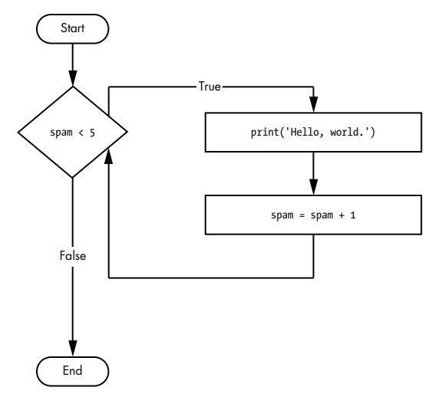
spam = 0
while spam < 5:
print('Hello, world.')
spam = spam + 1

Slide 60
break Statements
The program execution of a while loop’s clause can be terminated when the condition is true.
If the execution reaches a break statement, it immediately exits the while loop’s clause.
while True: # infinite loop
print('Please type your name.')
name = input()
if name == 'your name':
break
print('Thank you!')

Slide 61
continue Statements
while True: # infinite loop
print('Who are you?')
name = input()
if name != 'Joe':
continue
print('Hi, Joe. What is the paswd? ')
password = input()
if password == 'swordfish':
break
print('Access granted.')
continue statements are used inside loops.
When the program execution reaches a continue statement, the program execution immediately jumps back to the start of the loop and reevaluates the loop’s condition.
This can be used in the middle of block of code to skip few lines of code within the block
Is there any possibility of the while loop to terminate because of its condition???

Slide 62
break and continue statements can be used with for loop clause also
The continue statement will continue to the next value of the for loop’s counter, as if the program execution had reached the end of the loop and returned to the start.
In fact, continue and break statements can be used only inside while and for loops.

Slide 63
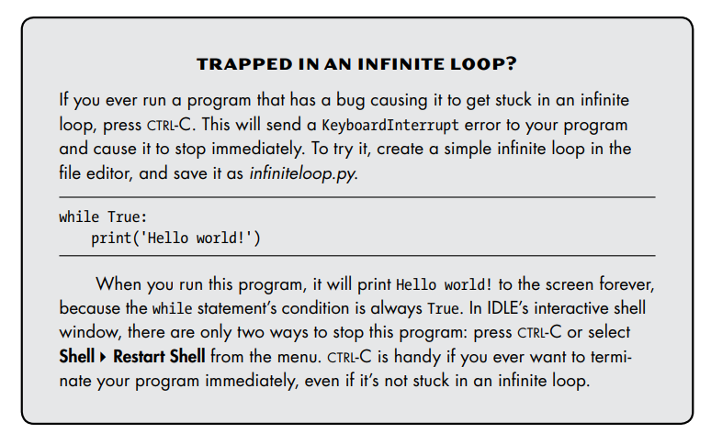

Slide 64
for Loops and the range() Function
It is used to execute a block of code for a certain number of times
for countervariable in range(count):
block of code ( for clause)
A for statement looks like
The for keyword
A variable name
The in keyword
A call to the range() method with up to three integers passed to it ( 1-999)
A colon (: )
Starting on the next line, an indented block of code (called the for clause)

Slide 65
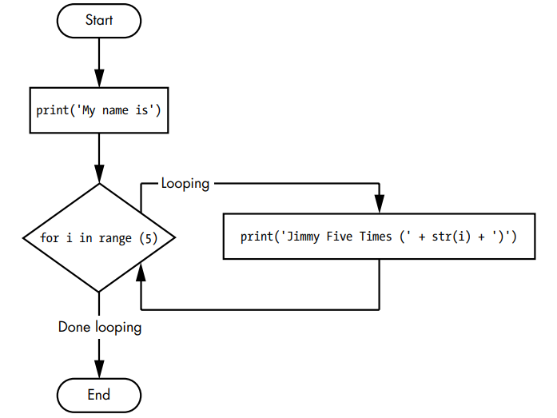
print('My name is')
for i in range(5):
print('Jimmy Five Times (' + str(i) + ')')
OUTPUT ???

Slide 66
The Starting, Stopping, and Stepping Arguments to range()
Some functions can be called with multiple arguments separated by a comma, and range() is one of them.
This lets to change the integer passed to range() to follow any sequence of integers, including starting at a number other than zero.
for i in range(12, 16):
print(i)
The first argument -12, will be where the for loop’s variable starts, and the second argument -16, will be up to, but not including, the number to stop at.
OUTPUT ???

Slide 67
The range() function can also be called with three arguments.
The first two arguments will be the start and stop values, and the third will be the step argument.
The step is the amount that the variable is increased by after each iteration.
for i in range(0, 10, 2):
print(i)
OUTPUT ???

Slide 68
The range() function is flexible in the sequence of numbers it produces for for loops.
A negative number can be used for the step argument to make the for loop count down instead of up.
for i in range(5, -1, -1):
print(i)
OUTPUT ???

Slide 69
Importing Modules
All Python programs can call a basic set of functions called built-in functions, like print(), input(), and len() functions.
Python has a set of modules called the standard library.
Each module is a Python program that contains a related group of functions that can be embedded in your programs.
Like, the math module has mathematics related functions, the random module has random number–related functions, and so on.
Before the functions are used in a module, the module must be imported with an import statement.

Slide 70
import
In code, an import statement consists of the following:
The import keyword
The name of the module
Optionally, more module names, separated by commas
After a module is imported, all the functions of that module can be used.
Ex1 - import random, sys, os, math
Ex2 - import random
for i in range(5):
print(random.randint(1, 10))
Here random, sys, os, math are modules and randint() is a function in the random module

Slide 71
from import Statements
An alternative form of the import statement is composed of the from keyword, followed by the module name, the import keyword, and a star *
from random import *
With this form of import statement, calls to functions in random will not need the random. prefix
from random import *
for i in range(5):
print(randint(1, 10))
However, using the full name makes for more readable code, so it is better to use the normal form of the import statement.

Slide 72
Both are same
import random
for i in range(5):
print(random.randint(1, 10))
from random import *
for i in range(5):
print(randint(1, 10))

Slide 73
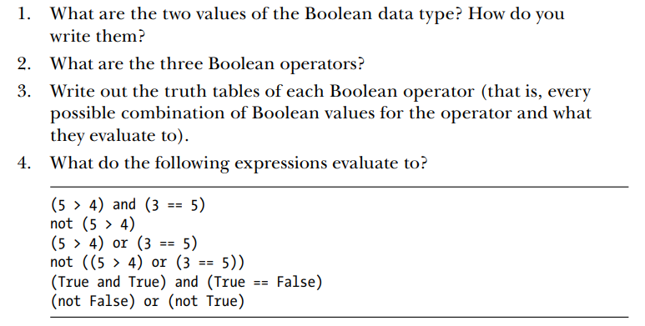
Assignment 2

Slide 74
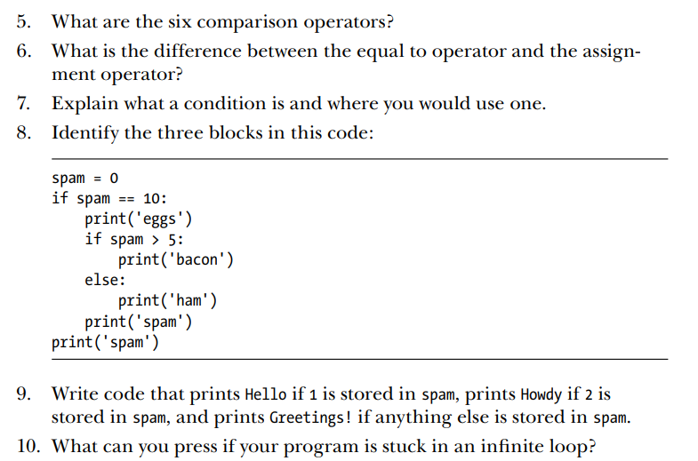

Slide 75
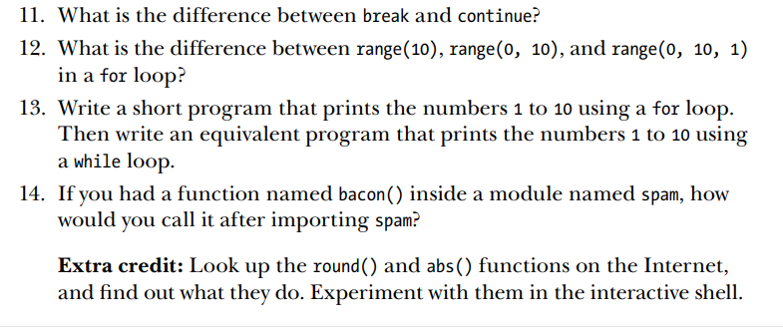

Slide 76
FUNCTIONS
The first line is a def statement, which defines a function.
def function_name():
body of function
return return_value
The code in the block that follows the def statement is the body of the function.
This code is executed when the function is called, not when the function is first defined.
In code, a function call is just the function’s name followed by parentheses, optionally with some number of arguments in between the parentheses.
When the program execution reaches these calls, it will jump to the top line in the function and begin executing the code there.
When it reaches the end of the function, the execution returns to the line that called the function and continues moving through the code as before.

Slide 77
def Statements with Parameters
Function definition can have parameters whose values are snt as arguments by calling function
def functionname(parameter1, parameter2, …, parameter n)
block of code
def hello(name):
print('Hello ' + name)
hello('Alice')
hello('Bob')

Slide 78
Return Values and return Statements
The value that a function call evaluates to is called the return value of the function.
When creating a function using the def statement, what the return value should be can be specified with a return statement.
A return statement consists of the following:
The return keyword
The value or expression that the function should return

Slide 79
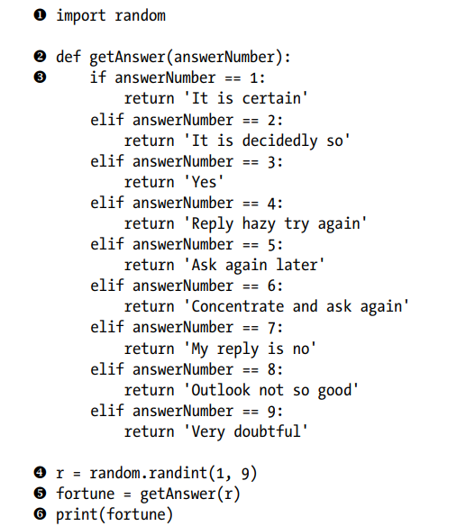
Function definition with parameter
Return with return value
Function Call with passing argument and receive return value

Slide 80
r = random.randint(1, 9)
fortune = getAnswer(r)
print(fortune)
Can be reduced to a single equivalent line:
print(getAnswer(random.randint(1, 9)))

Slide 81
The None Value
In Python there is a value called None, which represents the absence of a value.
None is the only value of the NoneType data type.
Other programming languages might call this value null, nil, or undefined.
None must be typed with a capital N.
This value-without-a-value can be helpful when you need to store something that won’t be confused for a real value in a variable.
One place where None is used is as the return value of print().
The print() function displays text on the screen, but it doesn’t need to return anything.
Python adds return None to the end of any function definition with no return statement or return without returnvalue

Slide 82
Keyword Arguments in print()
The print() function has the optional parameters end and sep to specify what should be printed at the end of its arguments and between its arguments (separating them), respectively
print(‘Hi’)
print(‘Hello’)
Would print in two separate lines as Hi
Hello
If it had to be printed in a single line then end should be used
print(‘Hi’, end=‘ ‘)
print(‘Hello’)
Output would be HiHello

Slide 83
when multiple string values are passed to print(), the function automatically separates them with a single space not comma
>>> print('cats', 'dogs', 'mice')
cats dogs mice
The default separating string could be replaced by passing the sep keyword argument
>>> print('cats', 'dogs', 'mice', sep=',')
cats,dogs,mice

Slide 84
Local and Global Scope
Parameters and variables that are assigned in a called function are said to exist in that function’s local scope.
Variables that are assigned outside all functions are said to exist in the global scope.
A variable that exists in a local scope is called a local variable, while a variable that exists in the global scope is called a global variable.
A variable must be one or the other; it cannot be both local and global.

Slide 85
Global Scope
Local Scope
There is only one global scope, and it is created when the program begins.
When the program terminates, the global scope is destroyed, and all its variables are forgotten.
A local scope is created whenever a function is called.
Any variables assigned in this function exist within the local scope.
When the function returns, the local scope is destroyed, and these variables are forgotten.
The next time you call this function, the local variables will be created again with new value.

Slide 86
Importance of scope
Scopes matter for several reasons:
Code in the global scope cannot use any local variables.
A local scope can access global variables.
Code in a function’s local scope cannot use variables in any other local scope.
Same name for different variables can be used if they are in different scopes.
That is, there can be a local variable named spam and a global variable also named spam.

Slide 87
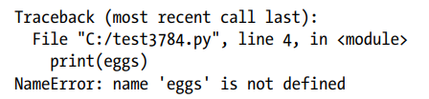
Local Variables Cannot Be Used in the Global Scope
OUTPUT ???
Error
def spam():
eggs = 31337
spam()
print(eggs)
eggs variable belongs to function spam, hence in local scope of spam
But print function is in global scope, hence cannot use eggs

Slide 88
Local Scopes Cannot Use Variables in Other Local Scopes
A new local scope is created whenever a function is called, and terminated when the called function returns.
Hence one function cannot use the variables of other function
def spam():
eggs = 99
bacon()
print(eggs)
def bacon():
ham = 101
eggs = 0
spam()
Program starts
spam() function is called, local scope of spam is created
eggs =99
bacon() function is called, local scope of bacon is created
ham =101 and eggs =0
bacon() returns None, local scope of bacon destroyed, hence no ham, no eggs=0
print function is called with parameter eggs, and since only local scope of spam exists 99 is printed

Slide 89
Global Variables Can Be Read from a Local Scope
def spam():
print(eggs)
eggs = 42
spam()
print(eggs)
Program starts
eggs = 42 is assigned – global variable
Function spam() is called
print function is called with eggs, so prints 42
Since there is no parameter named eggs in the spam() function, Python considers it a reference to the global variable eggs and prints 42
Spam returns with None
print function is called with eggs, so prints 42

Slide 90
Local and Global Variables with the Same Name (Try to avoid if possible though legal)
def spam():
eggs = 'spam local'
print(eggs) # prints 'spam local'
def bacon():
eggs = 'bacon local'
print(eggs) # prints 'bacon local'
spam()
print(eggs) # prints 'bacon local‘
eggs = 'global'
bacon()
print(eggs) # prints 'global'
OUTPUT ???
bacon local
spam local
bacon local
global

Slide 91
The global Statement
If there is a need to modify a global variable from within a function, the global statement should be used.
def spam():
global eggs
eggs = 'spam‘
eggs = 'global'
spam()
print(eggs)
Here though initially the global variable eggs is assigned the value ‘global’, inside the spam function it is modified as ‘spam’
OUTPUT ???

Slide 92
There are four rules to tell whether a variable is in a local scope or global scope:
If a variable is being used in the global scope (that is, outside of all functions), then it is always a global variable.
If there is a global statement for that variable in a function, it is a global variable.
Otherwise, if the variable is used in an assignment statement in the function, it is a local variable.
But if the variable is not used in an assignment statement, it is still a global variable.
def spam():
global eggs
eggs = 'spam'
def bacon():
eggs = 'bacon'
def ham():
print(eggs)
eggs = 42
spam()
print(eggs)
1
2
3
4
Which is local, which is global?

Slide 93
def spam():
print(eggs) # ERROR! WHY????
eggs = 'spam local'
eggs = 'global'
spam()
There is an assignment statement for eggs in the spam() function and therefore eggs is considered to be local. But because print(eggs) is executed before eggs is assigned something, error is displayed – reference before assignment

Slide 94
Exception Handling
Around 25 types of error types are there, few are like
SyntaxError
TypeError
NameError
ZeroDivisionError
RunTimeError
try :
block of code ( user code – valid clause)
except ErrorType:
Action (print error message)

Slide 95
def spam(divideBy):
try:
return 42 / divideBy
except ZeroDivisionError:
print('Error: Invalid argument.')
print(spam(2))
print(spam(12))
print(spam(0))
print(spam(1))
OUTPUT
21.0
3.5
Error: Invalid argument. None (returns None since division couldn’t happen)
42.0

Slide 96
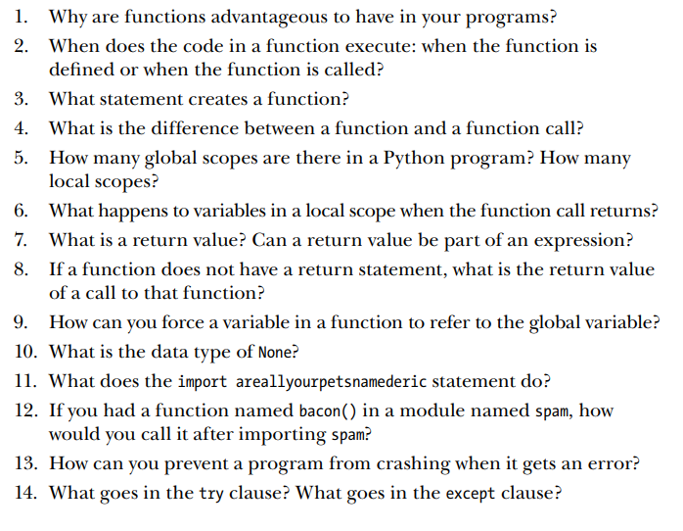
Assignment 3

Slide 97
15. Write a function named collatz() that has one parameter named number. If number is even, then collatz() should print number // 2 and return this value. If number is odd, then collatz() should print and return 3 * number + 1. Then write a program that lets the user type in an integer and that keeps calling collatz() on that number until the function returns the value 1.
16. Input Validation - Add try and except statements to the previous project to detect whether the user types in a noninteger string. Normally, the int() function will raise a ValueError error if it is passed a noninteger string, as in int('puppy'). In the except clause, print a message to the user saying they must enter an integer

